Slide 1
BUS 297D: Data Mining
Professor David Mease
Lecture 6
Agenda:
1) Reminder about HW #3 (Due Thurs 10/1)
2) Lecture over Chapter 5

Slide 2
Homework 3
Homework 3 is at
http://www.cob.sjsu.edu/mease_d/bus297D/homework3.html
It is due Thursday, October 1 during class
It is work 50 points
It must be printed out using a computer and turned in during the class meeting time. Anything handwritten on the homework will not be counted. Late homeworks will not be accepted.

Slide 3

Introduction to Data Mining
by
Tan, Steinbach, Kumar
Chapter 5: Classification: Alternative Techniques

Slide 4
The Class Imbalance Problem (Sec. 5.7, p. 204)
So far we have treated the two classes equally. We have assumed the same loss for both types of misclassification, used 50% as the cutoff and always assigned the label of the majority class.
This is appropriate if the following three conditions are met
1) We suffer the same cost for both types of errors
2) We are interested in the probability of 0.5 only
3) The ratio of the two classes in our training data will match that in the population to which we will apply the model

Slide 5
The Class Imbalance Problem (Sec. 5.7, p. 204)
If any one of these three conditions is not true, it may be desirable to “turn up” or “turn down” the number of observations being classified as the positive class.
This can be done in a number of ways depending on the classifier.
Methods for doing this include choosing a probability different from 0.5, using a threshold on some continuous confidence output or under/over-sampling.

Slide 6
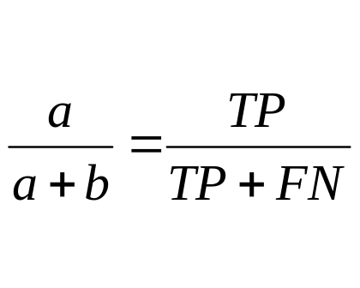
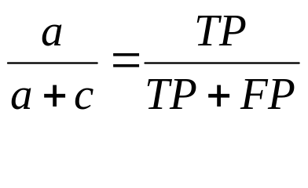
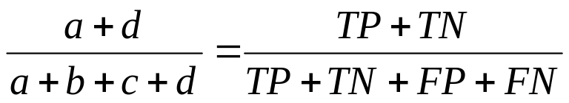
Recall and Precision (page 297)
When dealing with class imbalance it is often useful to look at recall and precision separately
Recall =
Precision =
Before we just used accuracy =
 | PREDICTED CLASS
ACTUAL CLASS |  | Class=Yes | Class=No
 | Class=Yes | a (TP) | b (FN)
 | Class=No | c (FP) | d (TN)

Slide 7
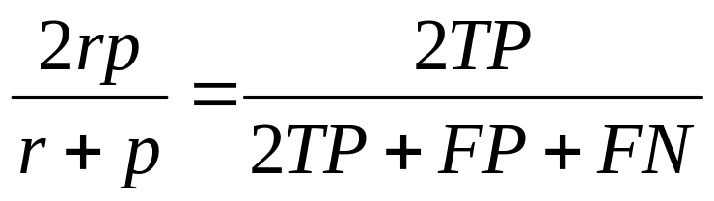
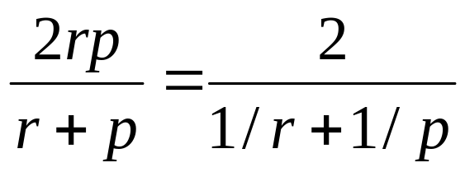
The F Measure (page 297)
F combines recall and precision into one number
F =
It equals the harmonic mean of recall and precision
Your book calls it the F₁ measure because it weights both recall and precision equally
See http://en.wikipedia.org/wiki/Information_retrieval

Slide 8
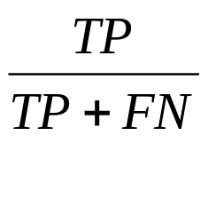
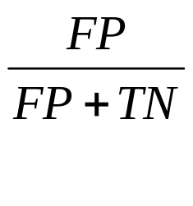
The ROC Curve (Sec 5.7.2, p. 298)
ROC stands for Receiver Operating Characteristic
Since we can “turn up” or “turn down” the number of observations being classified as the positive class, we can have many different values of true positive rate (TPR) and false positive rate (FPR) for the same classifier.
      TPR= FPR=
The ROC curve plots TPR on the y-axis and FPR on the x-axis

Slide 9
The ROC Curve (Sec 5.7.2, p. 298)
The ROC curve plots TPR on the y-axis and FPR on the x-axis
The diagonal represents random guessing
A good classifier lies near the upper left
ROC curves are useful for comparing 2 classifiers
The better classifier will lie on top more often
The Area Under the Curve (AUC) is often used a metric

Slide 10
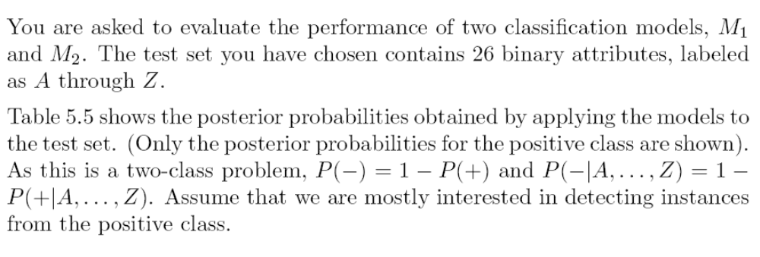
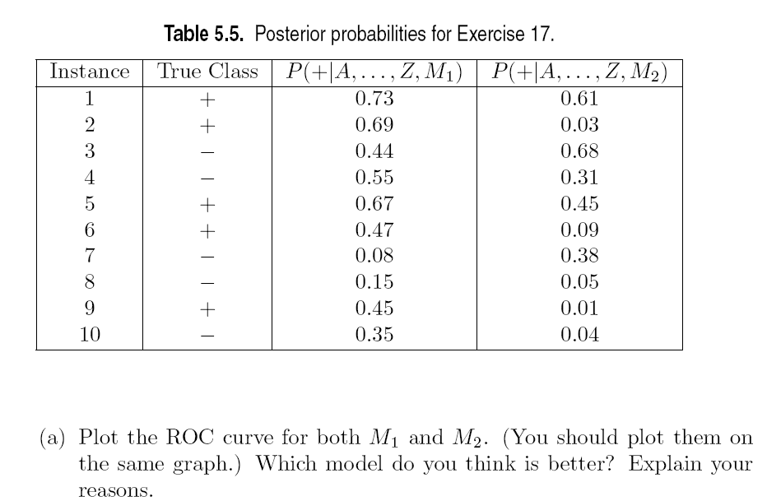
In class exercise #40:
This is textbook question #17 part (a) on page 322. It is part of your homework so we will not do all of it in class. We will just do the curve for M₁.

Slide 11
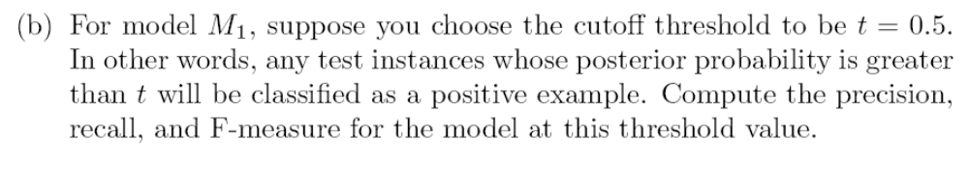
In class exercise #41:
This is textbook question #17 part (b) on page 322.

Slide 12
Additional Classification Techniques
Decision trees are just one method for classification
We will learn additional methods in this chapter:
- Nearest Neighbor
- Support Vector Machines
- Bagging
- Random Forests
- Boosting

Slide 13

Nearest Neighbor (Section 5.2, page 223)
You can use nearest neighbor classifiers if you have some way of defining “distances” between attributes
The k-nearest neighbor classifier classifies a point based on the majority of the k closest training points

Slide 14
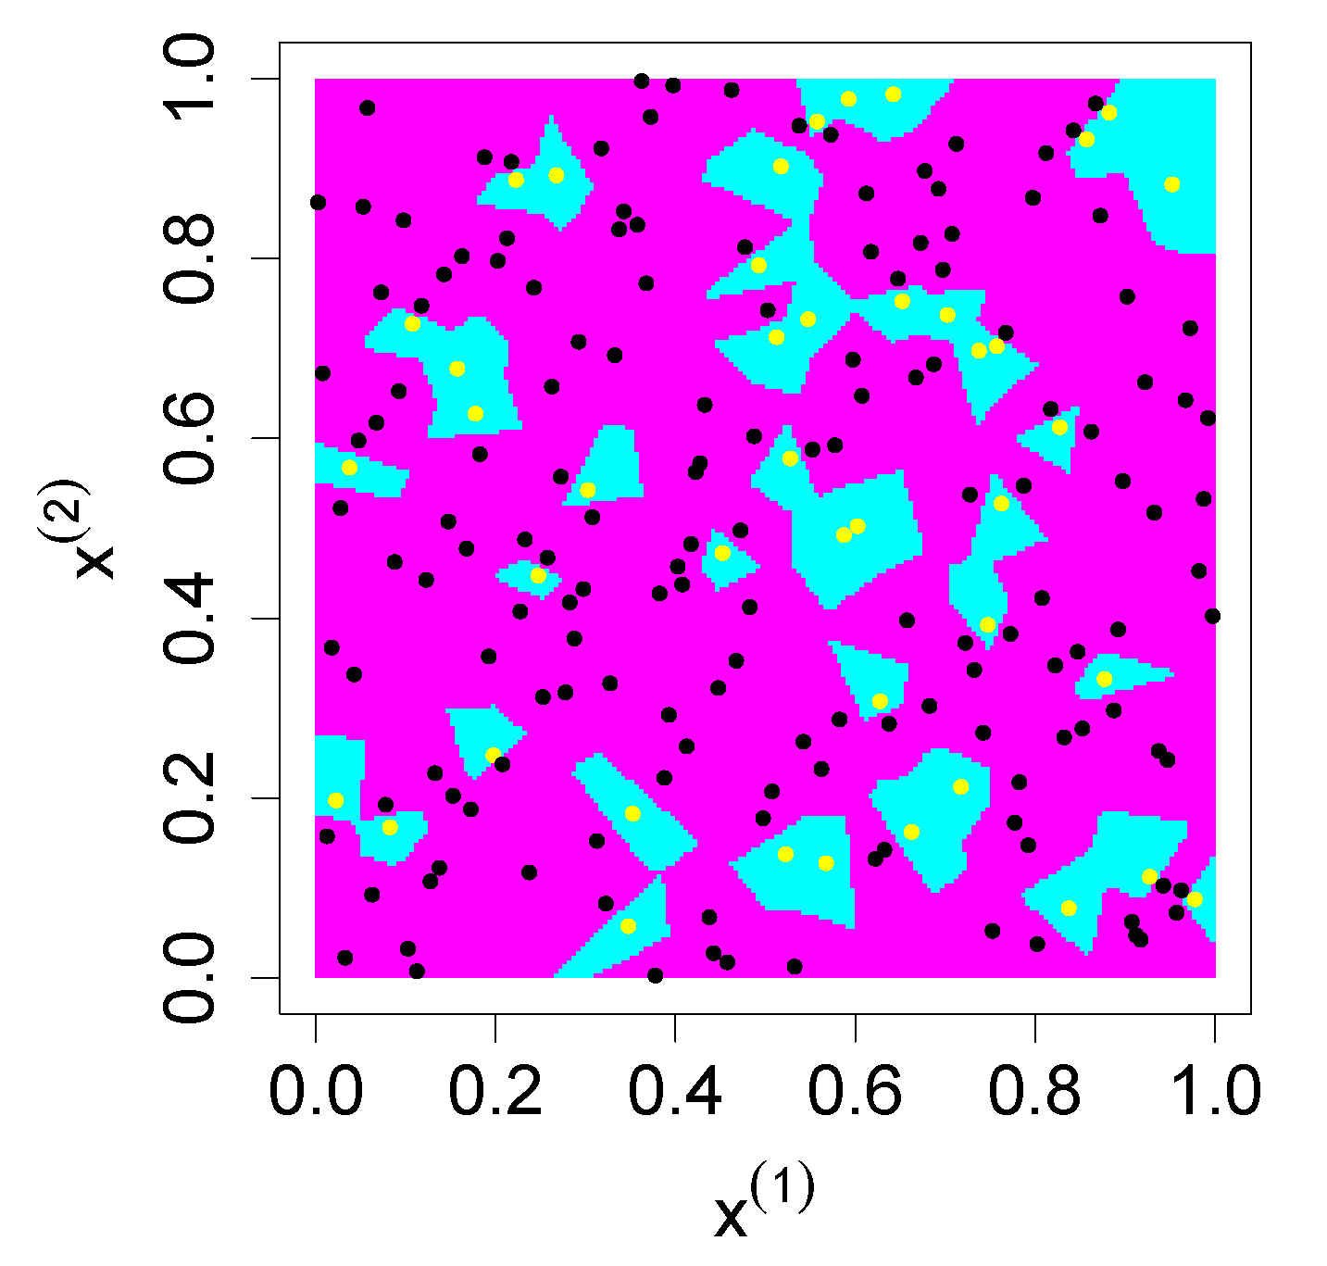
Nearest Neighbor (Section 5.2, page 223)
Here is a plot I made using R showing the 1-nearest neighbor classifier on a 2-dimensional data set.

Slide 15
Nearest Neighbor (Section 5.2, page 223)
Nearest neighbor methods work very poorly when the dimensionality is large (meaning there are a large number of attributes)
The scales of the different attributes are important. If a single numeric attribute has a large spread, it can dominate the distance metric. A common practice is to scale all numeric attributes to have equal variance.
The knn() function in R in the library “class” does a k-nearest neighbor classification using Euclidean distance.

Slide 16
In class exercise #42:
Use knn() in R to fit the 1-nearest-neighbor classifier to the last column of the sonar training data at
http://www-stat.wharton.upenn.edu/~dmease/sonar_train.csv
Use all the default values. Compute the misclassification error on the training data and also on the test data at
http://www-stat.wharton.upenn.edu/~dmease/sonar_test.csv

Slide 17
In class exercise #42:
Use knn() in R to fit the 1-nearest-neighbor classifier to the last column of the sonar training data at
http://www-stat.wharton.upenn.edu/~dmease/sonar_train.csv
Use all the default values. Compute the misclassification error on the training data and also on the test data at
http://www-stat.wharton.upenn.edu/~dmease/sonar_test.csv
Solution:
install.packages("class")
library(class)
train<-read.csv("sonar_train.csv",header=FALSE)
y<-as.factor(train[,61])
x<-train[,1:60]
fit<-knn(x,x,y,k=1)
1-sum(y==fit)/length(y)

Slide 18
In class exercise #42:
Use knn() in R to fit the 1-nearest-neighbor classifier to the last column of the sonar training data at
http://www-stat.wharton.upenn.edu/~dmease/sonar_train.csv
Use all the default values. Compute the misclassification error on the training data and also on the test data at
http://www-stat.wharton.upenn.edu/~dmease/sonar_test.csv
Solution (continued):
test<-read.csv("sonar_test.csv",header=FALSE)
y_test<-as.factor(test[,61])
x_test<-test[,1:60]
fit_test<-knn(x,x_test,y,k=1)
1-sum(y_test==fit_test)/length(y_test)

Slide 19
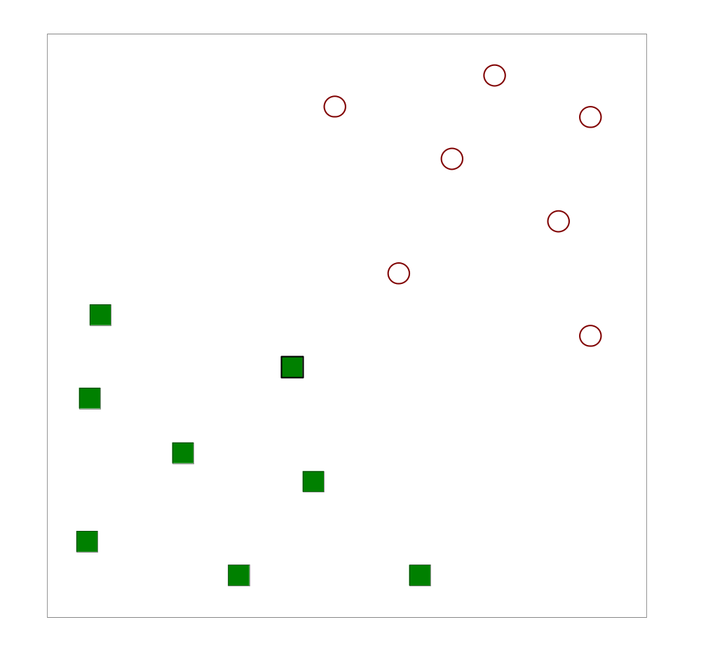
Support Vector Machines (Section 5.5, page 256)
If the two classes can be separated perfectly by a line in the x space, how do we choose the “best” line?

Slide 20
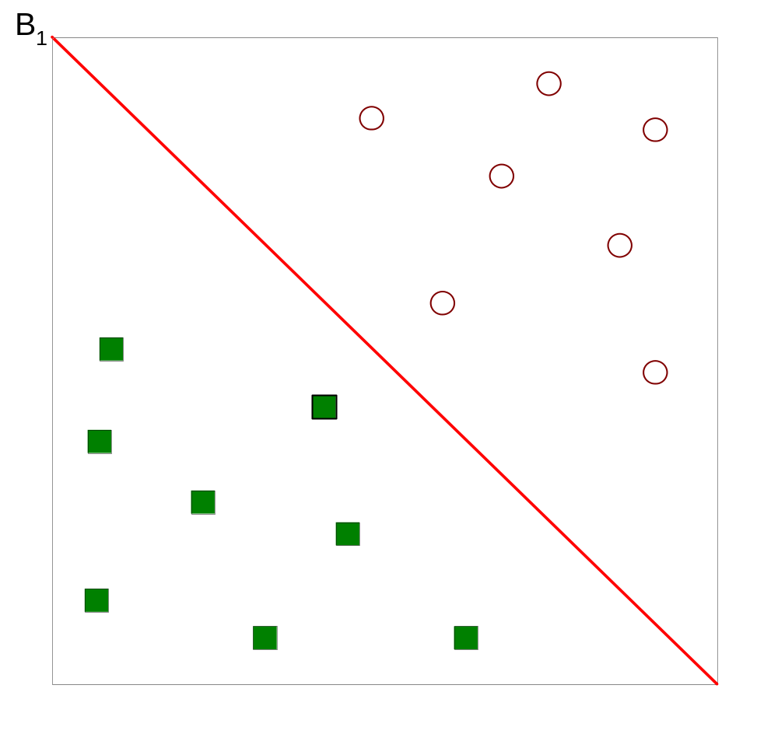
Support Vector Machines (Section 5.5, page 256)
If the two classes can be separated perfectly by a line in the x space, how do we choose the “best” line?

Slide 21
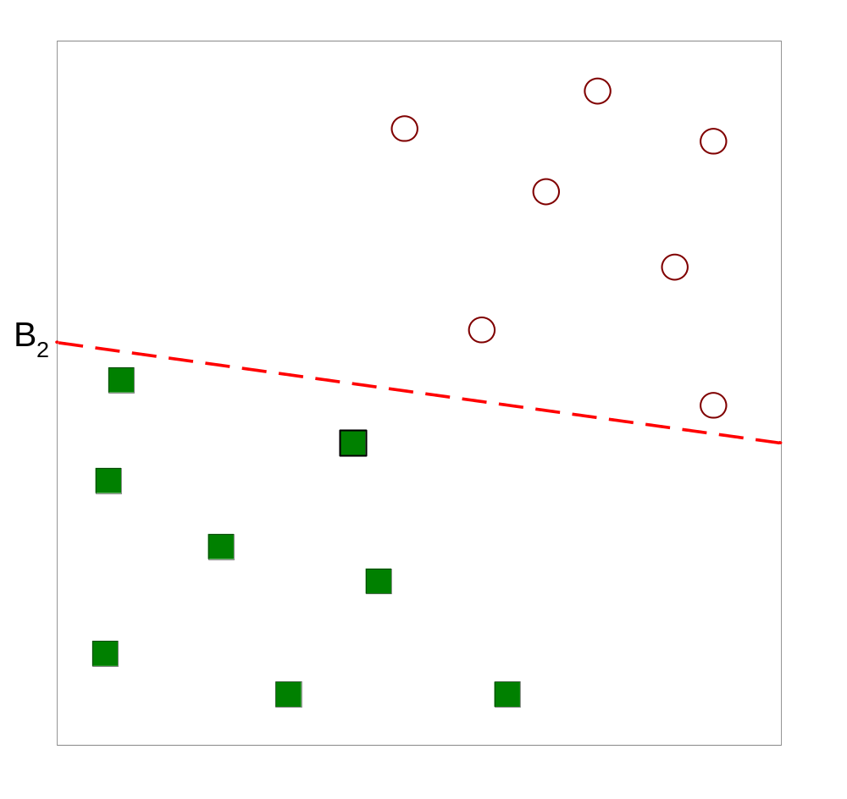
Support Vector Machines (Section 5.5, page 256)
If the two classes can be separated perfectly by a line in the x space, how do we choose the “best” line?

Slide 22
Support Vector Machines (Section 5.5, page 256)
If the two classes can be separated perfectly by a line in the x space, how do we choose the “best” line?

Slide 23
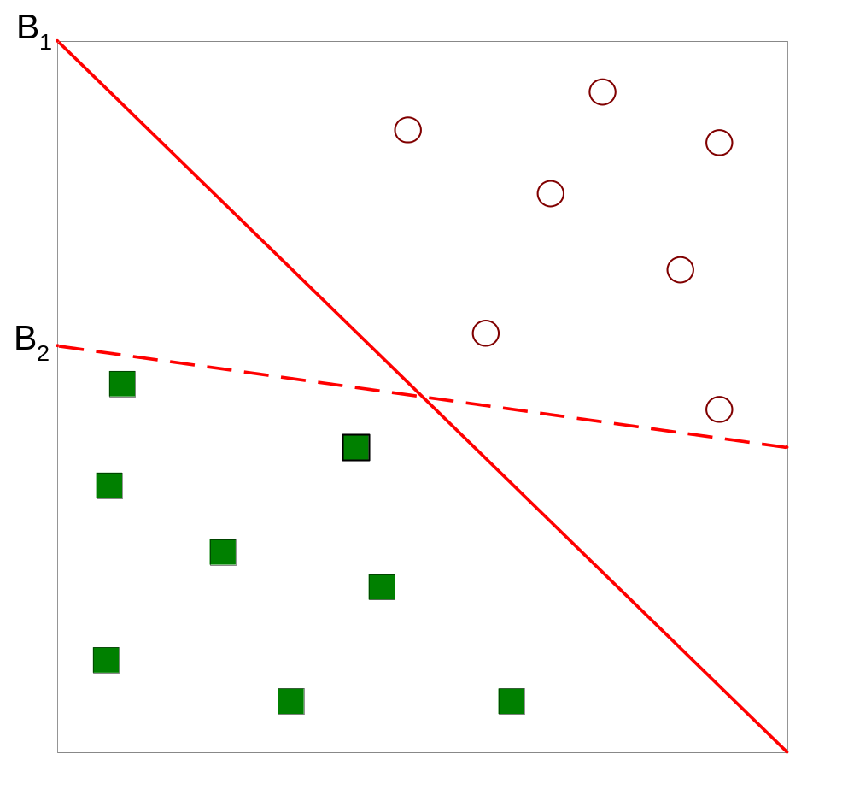
Support Vector Machines (Section 5.5, page 256)
If the two classes can be separated perfectly by a line in the x space, how do we choose the “best” line?

Slide 24
Support Vector Machines (Section 5.5, page 256)
One solution is to choose the line (hyperplane) with the largest margin. The margin is the distance between the two parallel lines on either side.
B
1
B
2
b
21
b
22
margin
b
11
b
12

Slide 25
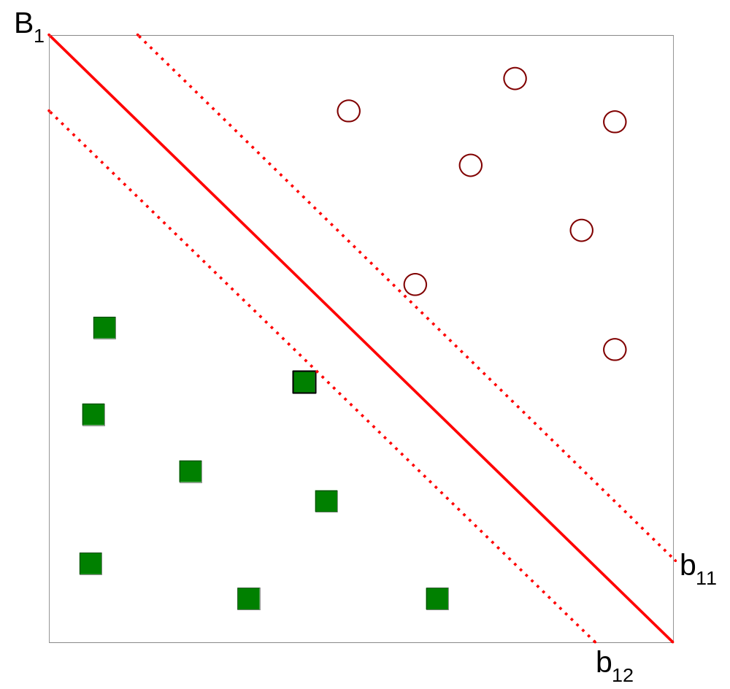




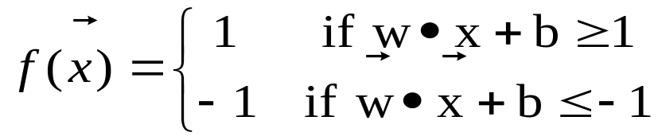
Support Vector Machines (Section 5.5, page 256)
Here is the notation your book uses:

Slide 26
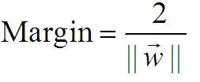
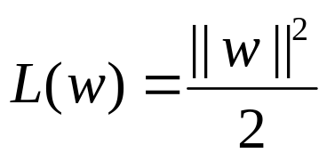
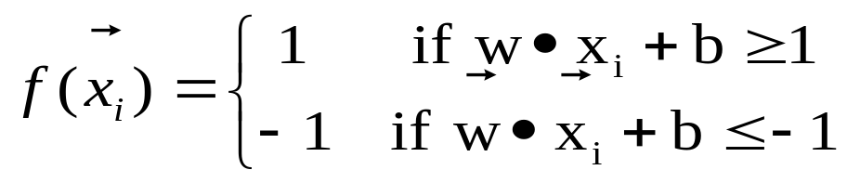
Support Vector Machines (Section 5.5, page 256)
This can be formulated as a constrained optimization problem.
We want to maximize
This is equivalent to minimizing
We have the following constraints
So we have a quadratic objective function with linear constraints which means it is a convex optimization problem and we can use Lagrange multipliers

Slide 27
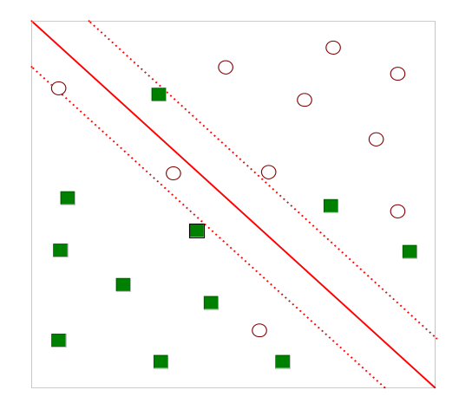
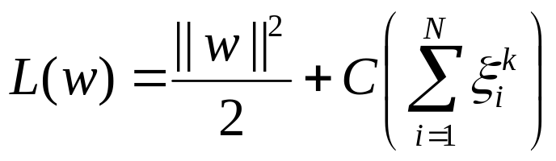
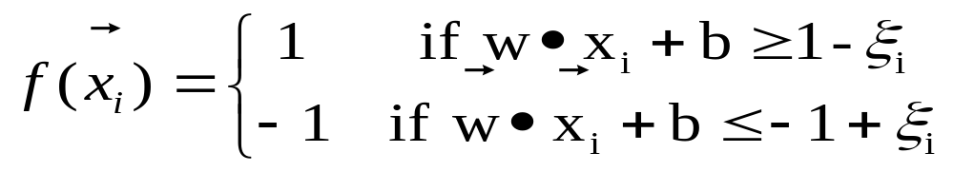
Support Vector Machines (Section 5.5, page 256)
What if the problem is not linearly separable?
Then we can introduce slack variables:
        Minimize
        Subject to

Slide 28
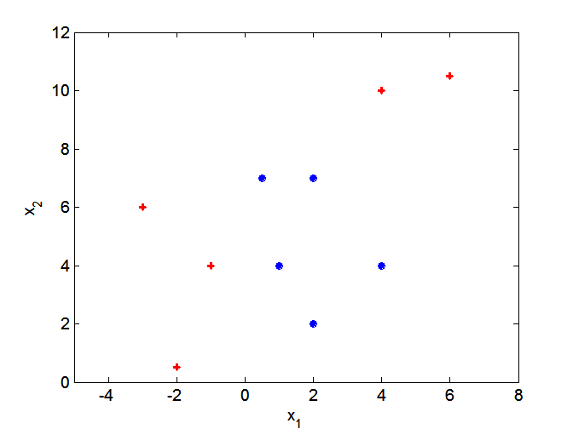
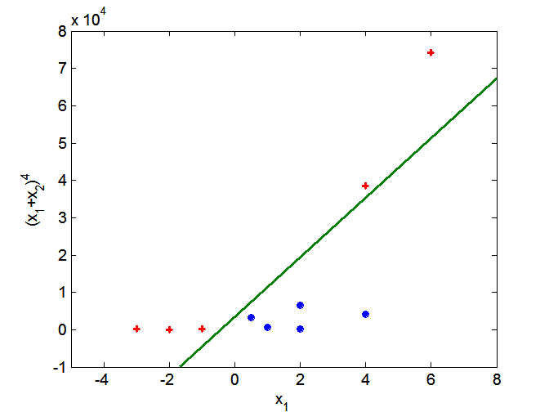
Support Vector Machines (Section 5.5, page 256)
What if the boundary is not linear?
Then we can use transformations of the variables to map into a higher dimensional space

Slide 29
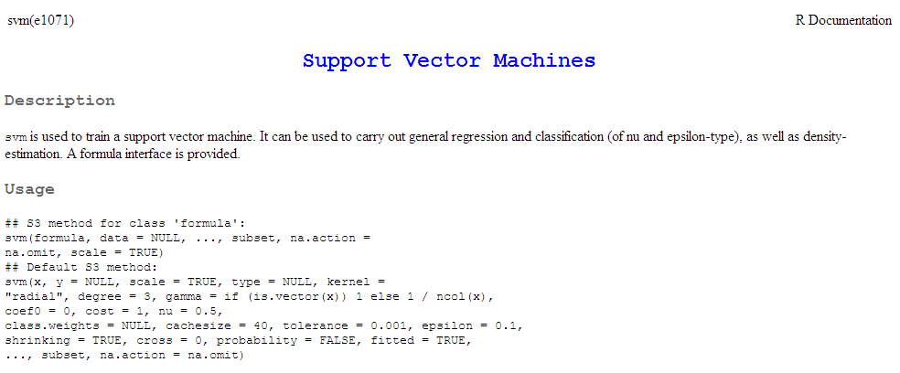
Support Vector Machines in R
The function svm in the package e1071 can fit support vector machines in R
Note that the default kernel is not linear – use kernel=“linear” to get a linear kernel

Slide 30
In class exercise #43:
Use svm() in R to fit the default svm to the last column of the sonar training data at
http://www-stat.wharton.upenn.edu/~dmease/sonar_train.csv
Compute the misclassification error on the training data and also on the test data at
http://www-stat.wharton.upenn.edu/~dmease/sonar_test.csv

Slide 31
In class exercise #43:
Use svm() in R to fit the default svm to the last column of the sonar training data at
http://www-stat.wharton.upenn.edu/~dmease/sonar_train.csv
Compute the misclassification error on the training data and also on the test data at
http://www-stat.wharton.upenn.edu/~dmease/sonar_test.csv
Solution:
install.packages("e1071")
library(e1071)
train<-read.csv("sonar_train.csv",header=FALSE)
y<-as.factor(train[,61])
x<-train[,1:60]
fit<-svm(x,y)
1-sum(y==predict(fit,x))/length(y)

Slide 32
In class exercise #43:
Use svm() in R to fit the default svm to the last column of the sonar training data at
http://www-stat.wharton.upenn.edu/~dmease/sonar_train.csv
Compute the misclassification error on the training data and also on the test data at
http://www-stat.wharton.upenn.edu/~dmease/sonar_test.csv
Solution (continued):
test<-read.csv("sonar_test.csv",header=FALSE)
y_test<-as.factor(test[,61])
x_test<-test[,1:60]
1-sum(y_test==predict(fit,x_test))/length(y_test)

Slide 33
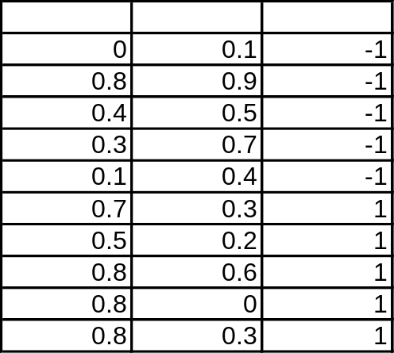
In class exercise #44:
Use svm() in R with kernel="linear“ and cost=100000 to fit the toy 2-dimensional data below. Provide a plot of the resulting classification rule.
x₁
x₂
y

Slide 34
In class exercise #44:
Use svm() in R with kernel="linear“ and cost=100000 to fit the toy 2-dimensional data below. Provide a plot of the resulting classification rule.
Solution:
x<-matrix(c(0,.1,.8,.9,.4,.5,
.3,.7,.1,.4,.7,.3,.5,.2,.8,.6,.8,0,.8,.3), ncol=2,byrow=T)
y<-as.factor(c(rep(-1,5),rep(1,5)))
plot(x,pch=19,xlim=c(0,1),ylim=c(0,1),
col=2*as.numeric(y),cex=2,
xlab=expression(x[1]),ylab=expression(x[2]))
x₁
x₂
y

Slide 35
In class exercise #44:
Use svm() in R with kernel="linear“ and cost=100000 to fit the toy 2-dimensional data below. Provide a plot of the resulting classification rule.
Solution (continued):
fit<-svm (x,y,kernel="linear",cost=100000)
big_x<-matrix(runif(200000),ncol=2,byrow=T)
points(big_x,col=rgb(.5,.5,
.2+.6*as.numeric(predict(fit,big_x)==1)),pch=19)
points(x,pch=19,col=2*as.numeric(y),cex=2)
x₁
x₂
y

Slide 36
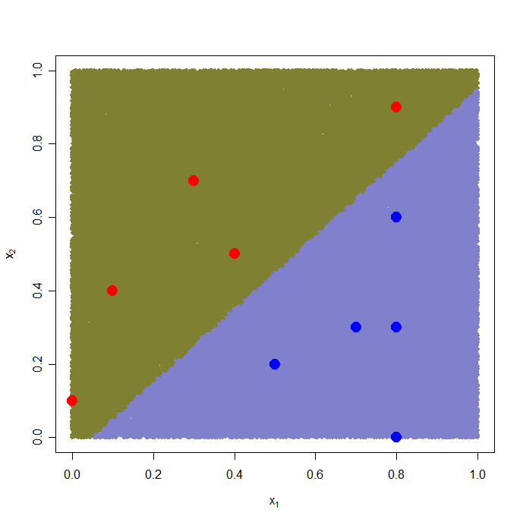
In class exercise #44:
Use svm() in R with kernel="linear“ and cost=100000 to fit the toy 2-dimensional data below. Provide a plot of the resulting classification rule.
Solution (continued):
x₁
x₂
y

Slide 37

Additional Classification Techniques
Decision trees are just one method for classification
We will learn additional methods in this chapter:
- Nearest Neighbor
- Support Vector Machines
- Bagging
- Random Forests
- Boosting

Slide 38
Ensemble Methods (Section 5.6, page 276)
Ensemble methods aim at “improving classification accuracy by aggregating the predictions from multiple classifiers” (page 276)
One of the most obvious ways of doing this is simply by averaging classifiers which make errors somewhat independently of each other

Slide 39
In class exercise #45:
Suppose I have 5 classifiers which each classify a point correctly 70% of the time. If these 5 classifiers are completely independent and I take the majority vote, how often is the majority vote correct for that point?

Slide 40
In class exercise #45:
Suppose I have 5 classifiers which each classify a point correctly 70% of the time. If these 5 classifiers are completely independent and I take the majority vote, how often is the majority vote correct for that point?
Solution (continued):
10*.7^3*.3^2 + 5*.7^4*.3^1 + .7^5
or
1-pbinom(2, 5, .7)

Slide 41
In class exercise #46:
Suppose I have 101 classifiers which each classify a point correctly 70% of the time. If these 101 classifiers are completely independent and I take the majority vote, how often is the majority vote correct for that point?

Slide 42
In class exercise #46:
Suppose I have 101 classifiers which each classify a point correctly 70% of the time. If these 101 classifiers are completely independent and I take the majority vote, how often is the majority vote correct for that point?
Solution (continued):
1-pbinom(50, 101, .7)

Slide 43
Ensemble Methods (Section 5.6, page 276)
Ensemble methods include
-Bagging (page 283)
-Random Forests (page 290)
-Boosting (page 285)
Bagging builds many classifiers by training on repeated samples (with replacement) from the data
Random Forests averages many trees which are constructed with some amount of randomness
Boosting combines simple base classifiers by upweighting data points which are classified incorrectly

Slide 44
Bagging (Section 5.6.4, page 283)
Bagging builds many classifiers by training on repeated samples (with replacement) from the data
Often the samples are made to have the same number of observations as the original data
Because the sampling is done with replacement, the samples will contain replicates

Slide 45
Random Forests (Section 5.6.6, page 290)
One way to create random forests is to grow decision trees top down but at each node consider only a random subset of attributes for splitting instead of all the attributes
Random Forests are a very effective technique
They are based on the paper
L. Breiman. Random forests. Machine Learning, 45:5-32, 2001
They can be fit in R using the function randomForest() in the library randomForest

Slide 46
In class exercise #47:
Use randomForest() in R to fit the default Random Forest to the last column of the sonar training data at
http://www-stat.wharton.upenn.edu/~dmease/sonar_train.csv
Compute the misclassification error for the test data at
http://www-stat.wharton.upenn.edu/~dmease/sonar_test.csv

Slide 47
In class exercise #47:
Use randomForest() in R to fit the default Random Forest to the last column of the sonar training data at
http://www-stat.wharton.upenn.edu/~dmease/sonar_train.csv
Compute the misclassification error for the test data at
http://www-stat.wharton.upenn.edu/~dmease/sonar_test.csv
Solution:
install.packages("randomForest")
library(randomForest)
train<-read.csv("sonar_train.csv",header=FALSE)
test<-read.csv("sonar_test.csv",header=FALSE)
y<-as.factor(train[,61])
x<-train[,1:60]
y_test<-as.factor(test[,61])
x_test<-test[,1:60]
fit<-randomForest(x,y)
1-sum(y_test==predict(fit,x_test))/length(y_test)

Slide 48
Boosting (Section 5.6.5, page 285)
Boosting has been called the “best off-the-shelf classifier in the world”
There are a number of explanations for boosting, but it is not completely understood why it works so well
The original popular algorithm is AdaBoost from

Slide 49
Boosting (Section 5.6.5, page 285)
Boosting can use any classifier as its weak learner (base classifier) but classification trees are by far the most popular
Boosting usually gives zero training error, but rarely overfits which is very curious

Slide 50
Boosting (Section 5.6.5, page 285)
Boosting works by upweighing points at each iteration which are misclassified
On paper, boosting looks like an optimization (similar to maximum likelihood estimation), but in practice it seems to benefit a lot from averaging like Random Forests does
There exist R libraries for boosting, but these are written by statisticians who have their own views of boosting, so I would not encourage you to use them
The best thing to do is to write code yourself since the algorithms are very basic

Slide 51
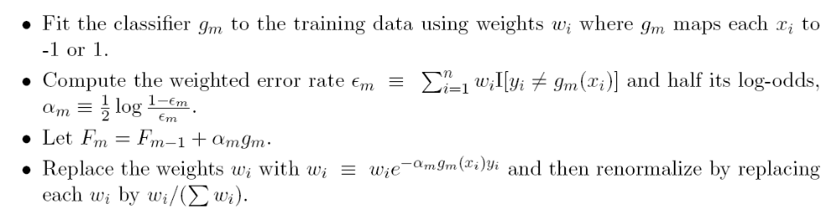
AdaBoost
Here is a version of the AdaBoost algorithm
The algorithm repeats until a chosen stopping time
The final classifier is based on the sign of F_{m}

Slide 52
In class exercise #48:
Use R to fit the AdaBoost classifier to the last column of the sonar training data at
http://www-stat.wharton.upenn.edu/~dmease/sonar_train.csv
Plot the misclassification error for the training data and the test data at
http://www-stat.wharton.upenn.edu/~dmease/sonar_test.csv
as a function of the iterations. Run the algorithm for 500 iterations. Use default rpart() as the base learner.
Solution:
train<-read.csv("sonar_train.csv",header=FALSE)
test<-read.csv("sonar_test.csv",header=FALSE)
y<-train[,61]
x<-train[,1:60]
y_test<-test[,61]
x_test<-test[,1:60]

Slide 53
In class exercise #48:
Use R to fit the AdaBoost classifier to the last column of the sonar training data at
http://www-stat.wharton.upenn.edu/~dmease/sonar_train.csv
Plot the misclassification error for the training data and the test data at
http://www-stat.wharton.upenn.edu/~dmease/sonar_test.csv
as a function of the iterations. Run the algorithm for 500 iterations. Use default rpart() as the base learner.
Solution (continued):
train_error<-rep(0,500)
test_error<-rep(0,500)
f<-rep(0,130)
f_test<-rep(0,78)
i<-1
library(rpart)

Slide 54
In class exercise #48:
Use R to fit the AdaBoost classifier to the last column of the sonar training data at
http://www-stat.wharton.upenn.edu/~dmease/sonar_train.csv
Plot the misclassification error for the training data and the test data at
http://www-stat.wharton.upenn.edu/~dmease/sonar_test.csv
as a function of the iterations. Run the algorithm for 500 iterations. Use default rpart() as the base learner.
Solution (continued):
while(i<=500){
w<-exp(-y*f)
w<-w/sum(w)
fit<-rpart(y~.,x,w,method="class")
g<--1+2*(predict(fit,x)[,2]>.5)
g_test<--1+2*(predict(fit,x_test)[,2]>.5)
e<-sum(w*(y*g<0))

Slide 55
In class exercise #48:
Use R to fit the AdaBoost classifier to the last column of the sonar training data at
http://www-stat.wharton.upenn.edu/~dmease/sonar_train.csv
Plot the misclassification error for the training data and the test data at
http://www-stat.wharton.upenn.edu/~dmease/sonar_test.csv
as a function of the iterations. Run the algorithm for 500 iterations. Use default rpart() as the base learner.
Solution (continued):
alpha<-.5*log ( (1-e) / e )
f<-f+alpha*g
f_test<-f_test+alpha*g_test
train_error[i]<-sum(1*f*y<0)/130
test_error[i]<-sum(1*f_test*y_test<0)/78
i<-i+1
}

Slide 56
In class exercise #48:
Use R to fit the AdaBoost classifier to the last column of the sonar training data at
http://www-stat.wharton.upenn.edu/~dmease/sonar_train.csv
Plot the misclassification error for the training data and the test data at
http://www-stat.wharton.upenn.edu/~dmease/sonar_test.csv
as a function of the iterations. Run the algorithm for 500 iterations. Use default rpart() as the base learner.
Solution (continued):
plot(seq(1,500),test_error,type="l",
ylim=c(0,.5),
ylab="Error Rate",xlab="Iterations",lwd=2)
lines(train_error,lwd=2,col="purple")
legend(4,.5,c("Training Error","Test Error"),
col=c("purple","black"),lwd=2)

Slide 57
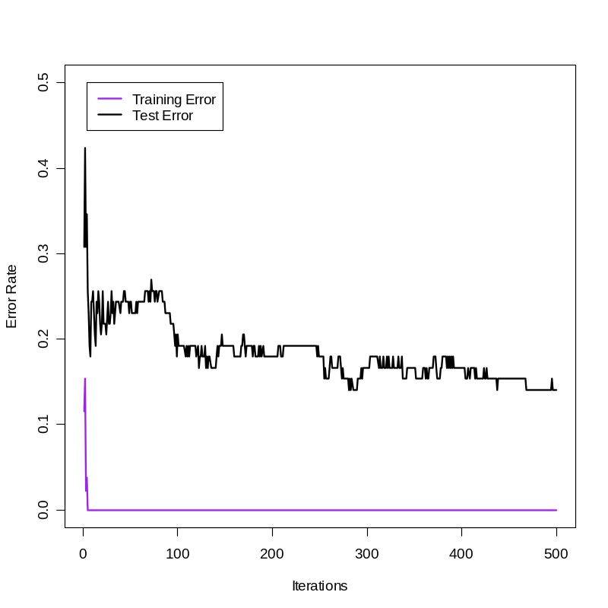
In class exercise #48:
Use R to fit the AdaBoost classifier to the last column of the sonar training data at
http://www-stat.wharton.upenn.edu/~dmease/sonar_train.csv
Plot the misclassification error for the training data and the test data at
http://www-stat.wharton.upenn.edu/~dmease/sonar_test.csv
as a function of the iterations. Run the algorithm for 500 iterations. Use default rpart() as the base learner.
Solution (continued):

